Slide 1
Physical examination
General

Slide 2
How to start
W ash hand before and after, wear gloves where appropriate
I ntroduce yourself to the patient and seek his or her consent
P osition the patient correctly
E xpose the patient as needed
R ight side of the bed

Slide 3
First impression
What can you see at the first glance at the patient?
Habitus
level of consciousness
patient position, posture, gait
body type – constitution
Vital signs
Nutrition

Slide 4
Level of consciousness
Obnibulation Somnolention
Stupor
Sopor
Coma

Slide 5
Patient position
Active
Passive
Forced position

Slide 6
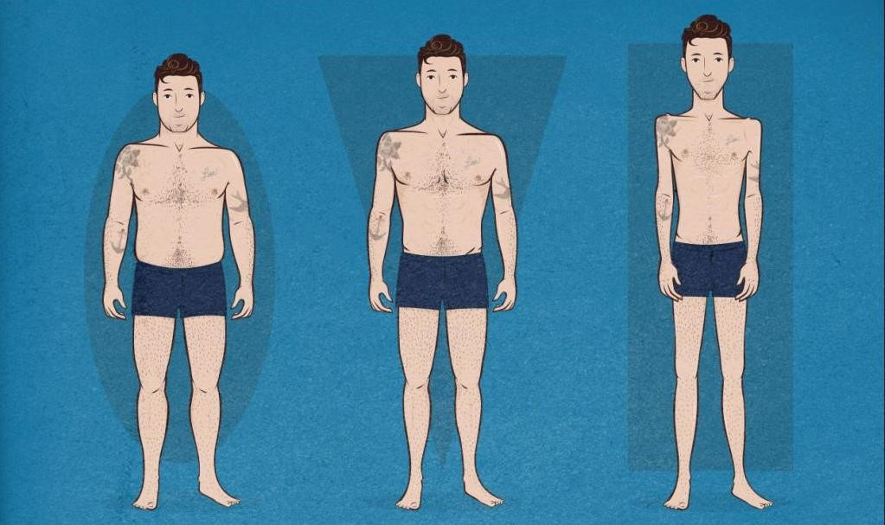
Hypersthenic
Normostenic
Asthenic

Slide 7
Overweighting and obesity
BMI | Classification^{[16]}
< 18.5 | underweight
18.5–24.9 | normal weight
25.0–29.9 | overweight
30.0–34.9 | class I obesity
35.0–39.9 | class II obesity
≥ 40.0 | class III obesity

Slide 8
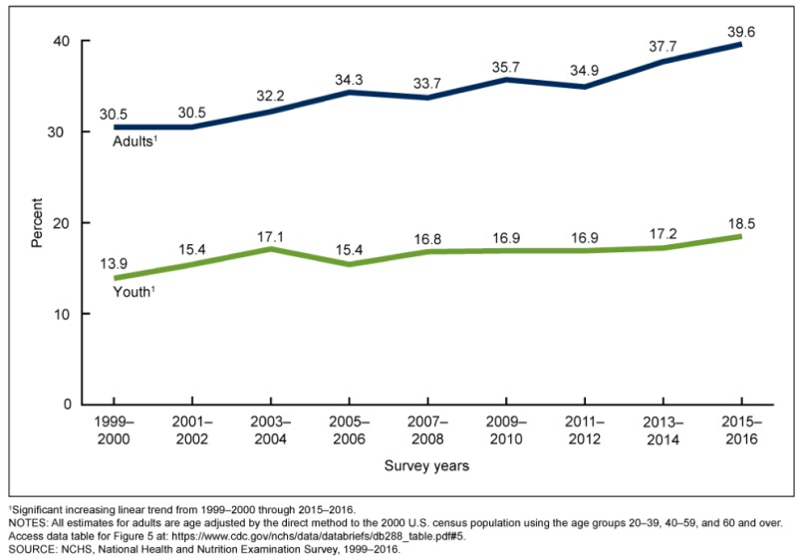

Slide 9
Waist Circumference
Norm | Abdominal (visceral) obesity
Men ≤40 inches (≤ 102 cm) | >40 in (> 102 cm)
Women ≤ 35 inches (≤ 88 cm) | > 35 in (> 88 cm)

Slide 10
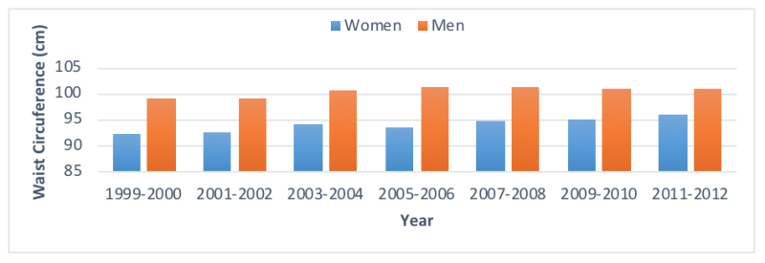

Slide 11
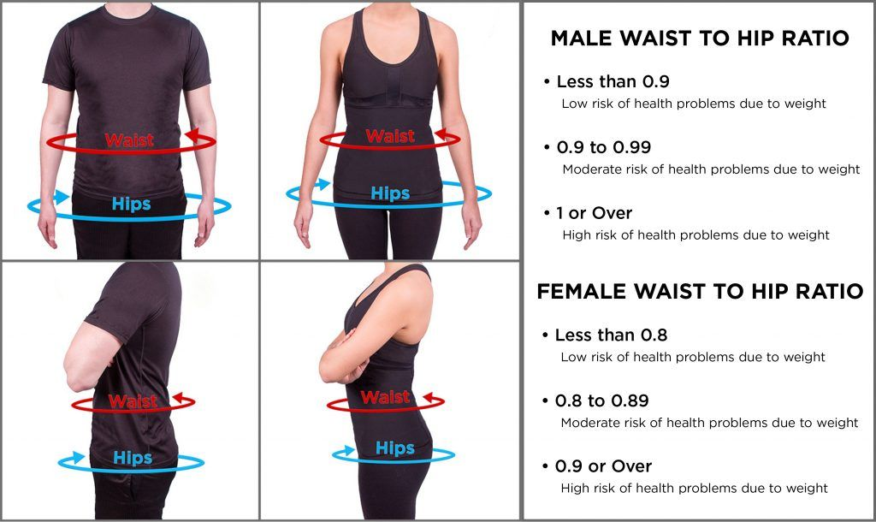
The waist-hip ratio or waist-to-hip ratio (WHR)

Slide 12
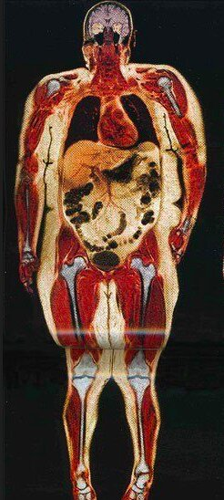
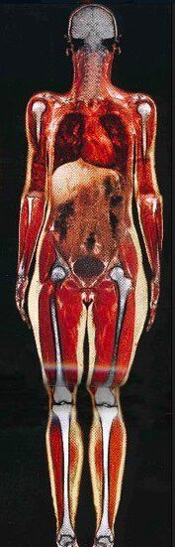
Body scan of one woman
113 kg and 55 kg.
Pay attention to the heart, liver, stomach, intestines, joints, etc.

Slide 13
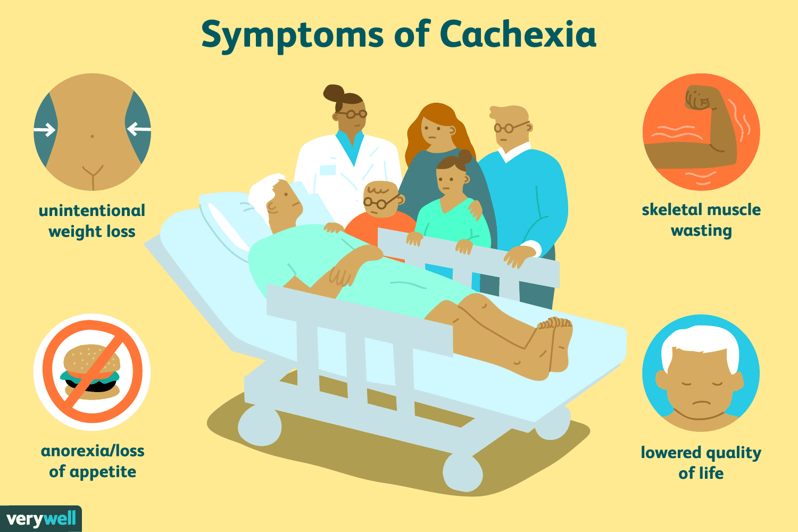
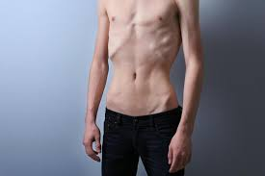
Weight loss
Cachexia

Slide 14
Face
Form
Shape
Appearance
Character
Face expression
Agitation

Slide 15
Diagnostic faces
Acromegalic
Cushing’s syndrome
Down’ s
Mixoedema
Facies Basedovica
Risus sardinicus
Hippocratic
Cyanosis
Facies febris
Facies Corvisar
Facies nephritica
Facies mitralis

Slide 16
Skin color
Cyanosis – central / acrocyanosis
Pallor
Hyperemia
Jaundice - Icterus
Pigmentation – hyper, hypo
Rash=Exanthema

Slide 17
Skin – texture, hydration, turgor
smooth
rough
dry
wet
oily

Slide 18
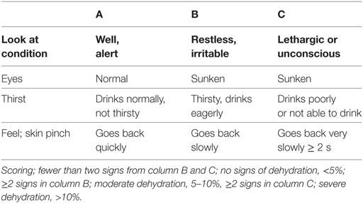
Dehydration signs

Slide 19
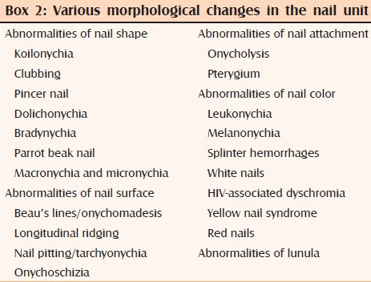
Nails

Slide 20
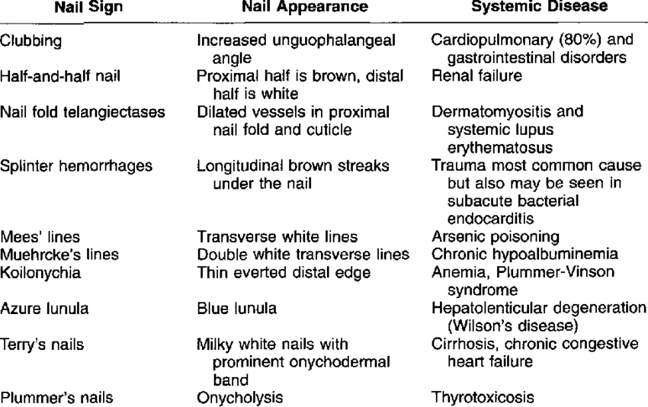

Slide 21
Vital signs
Body temperature
Pulse
Blood pressure
Respiratory rate

Slide 22
Body temperature
 | Normal | Fever
Mouth | 37,8 ˚C | >37,3˚C
Axilla | 36,4 ˚C | >36,9˚C
Rectum | 37,3 ˚C | >37,7˚C

Slide 23
Normal and febrile body temperature ranges (rectal temperatures)
BODY TEMPERATURE | °C | °F
Normal | 37–38 | 98.6–100.4
Mild/low grade fever | 38.1–39 | 100.5–102.2
Moderate grade fever | 39.1–40 | 102.2–104.0
High grade fever | 40.1–41.1 | 104.1–106.0
Hyperpyrexiaª | >41.1 | >106.0

Slide 24
Smell
Notable odour
The smell of rotting apples | Sickly sweet smell of patients with ketoacidosis – diabetes mellitus
the smell of chocolate | Sweet smell of acute lever failure
Fish breath | Ammoniacal – ureamic odour
Smell of sigarette | Smoking patient

Slide 25
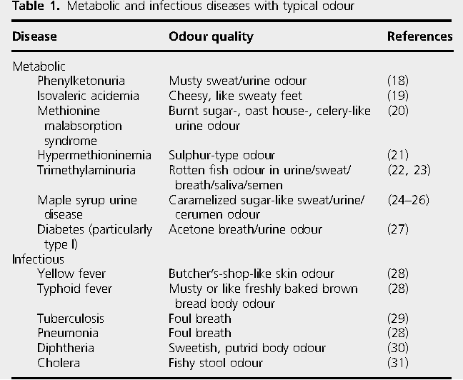

Slide 26
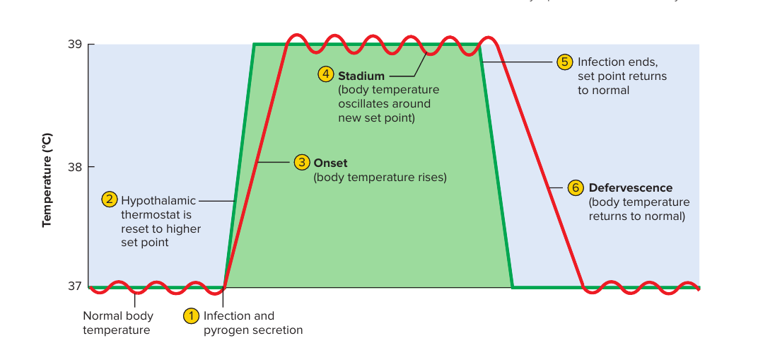
What symptoms (patient complaints, objective data) can you identify at each stage of the fever?

Slide 27
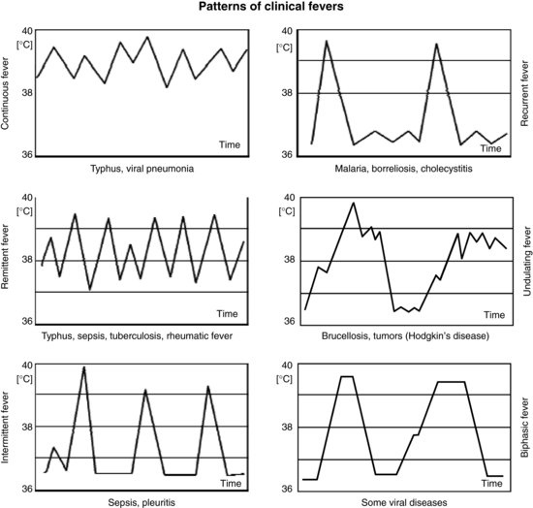

Slide 28
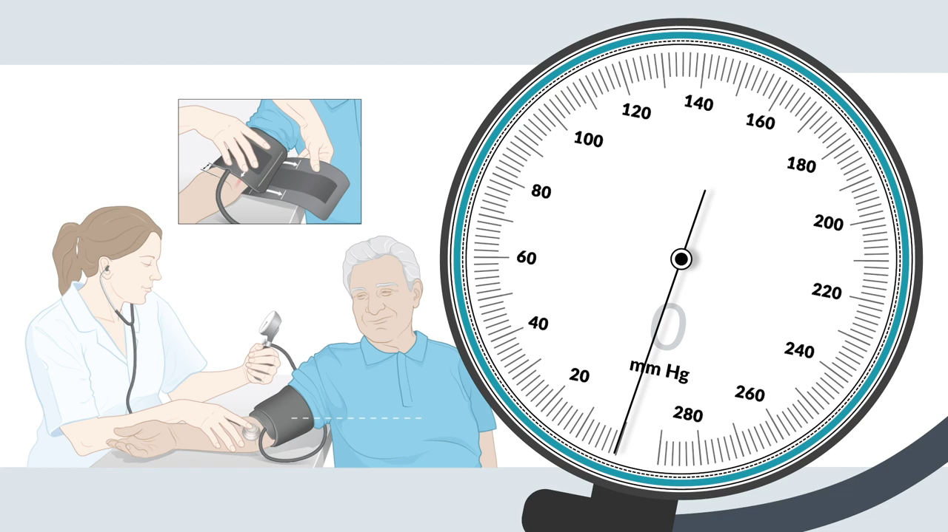

Slide 29
Lymphatic nodules
Location
Size | Normal nodes in adults are <0.5 cm in diameter
Attachments | Lymph nodes fixed to deep structures or skin suggest malignancy
Consistency | Normal nodes feel soft in Hodgkin’s disease they are characteristically ‘rubbery’, in tuberculosis they may be ‘matted’, and in metastatic cancer they feel hard
Tenderness | Acute viral or bacterial infection, including infectious mononucleosis, dental sepsis and tonsillitis, causes tender, variably enlarged lymph nodes

Slide 30
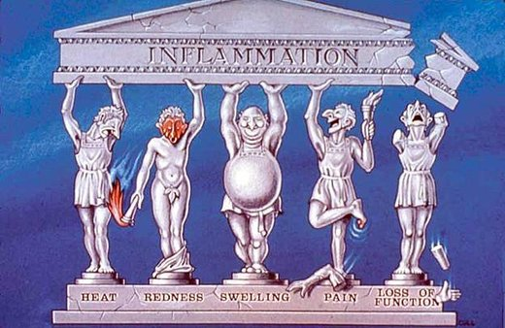
Calor Rubor Tumor Dolor Functio laesa

Slide 31
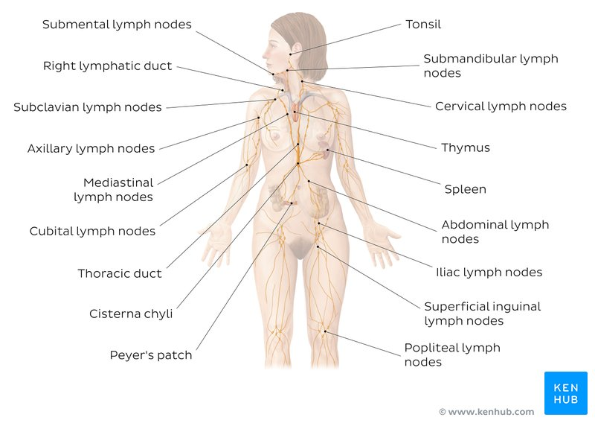

Slide 32
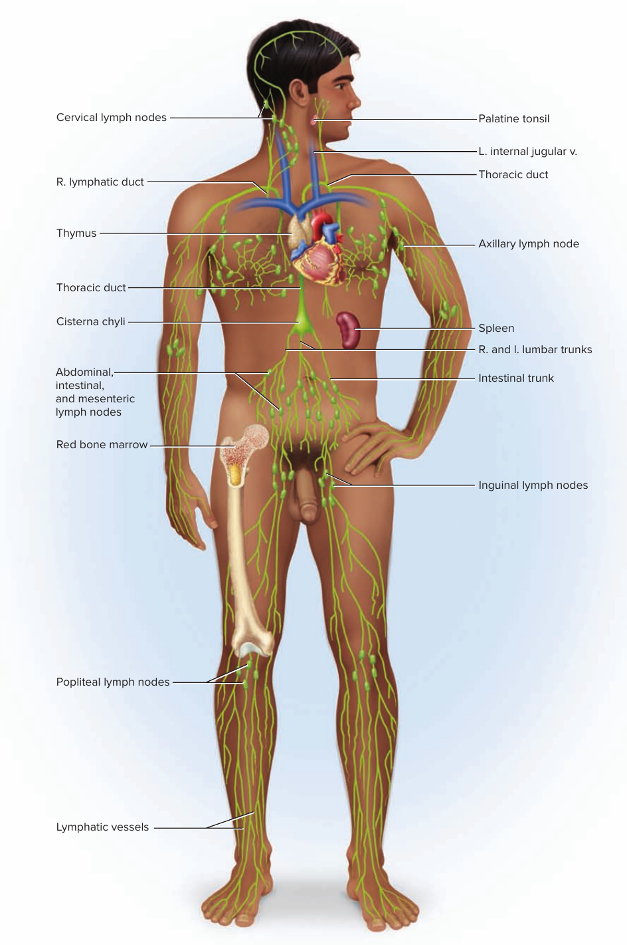

Slide 33
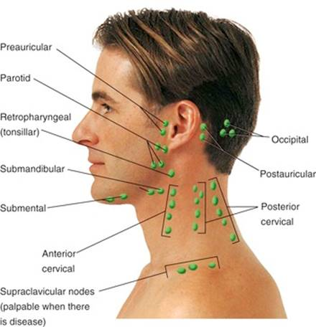

Slide 34
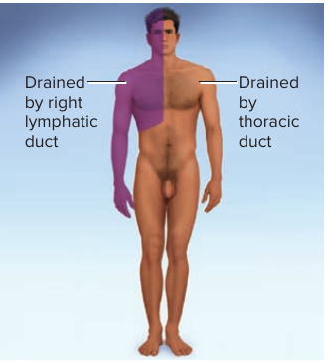

Slide 35
